Slide 1
WELCOME

Slide 2
CADD MULTI-SPECIALITY HOSPITAL
Hospital Management System
A C-Language Based Management Information System
A GUIDANCE FOR
Patient
Employee
Administrator

Slide 3
About C Programming Language
C
Language
C is a powerful, general-purpose procedural programming language widely considered the foundational language of modern computer science. It offers a balance of high-level efficiency and low-level hardware control.
System Programming
Building operating systems like Linux and Windows
Developed by
Dennis Ritchie
Bell Labs, 1972
Hardware Interaction
Writing drivers to communicate directly with devices
Firmware Development
General-Purpose
Procedural Language
Programming microcontrollers and embedded systems
Core Engines
Powering databases, game engines, and compilers

Slide 4
Advantages of C Language
High Efficiency
Portability
Low-Level Access
Executes code rapidly close to machine speed
Runs on multiple hardware platforms with minimal changes
Allows direct memory manipulation using pointers
Rich Libraries
Modular Structure
Foundation Language
Built-in functions for handling complex tasks
Organizes code into reusable functions easily
Basis for C++, Java, and Python

Slide 5
System Overview
Patient
Module
CADD Hospital
HOSPITAL MANAGEMENT SYSTEM
Admin
Module
System Features
Role-based access control
Department routing by symptoms
Employee & leave management
File-based record storage
Real-time admin dashboard
Employee
Module

Slide 6
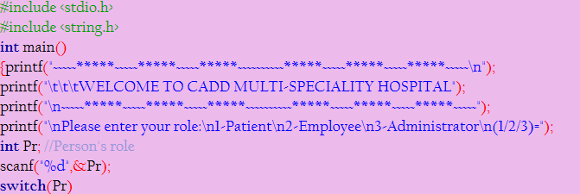
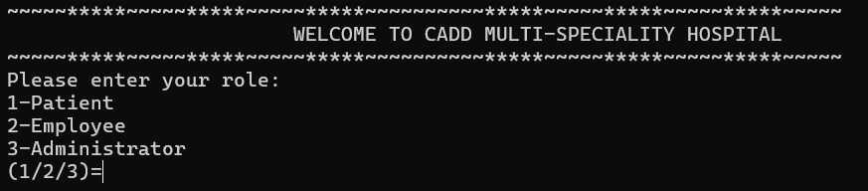
This module identifies the role of the user accessing the Hospital Management System and directs them to the appropriate section. It enables patients, employees, and administrators to access services relevant to their needs, ensuring efficient and organized management.

Slide 7
PATIENT
(CASE 1)

Slide 8
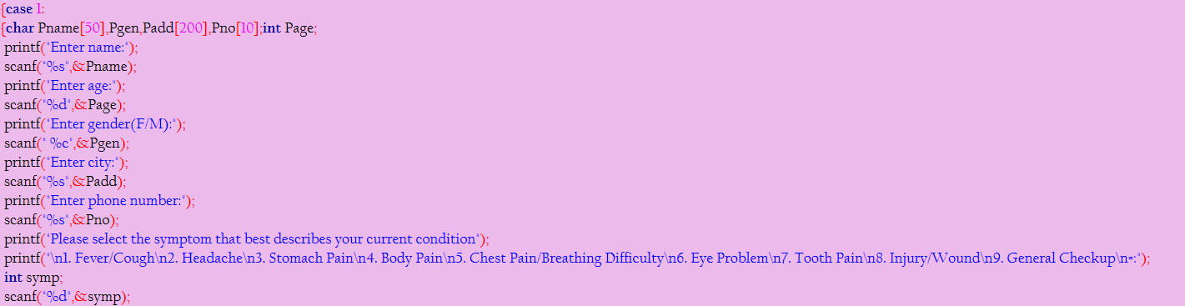
Patient Module
This module records the patient's details and symptoms,
enabling efficient patient registration and department allocation.
USING SCANF TO
RECORD AND STORE
THE DETAILS

Slide 9
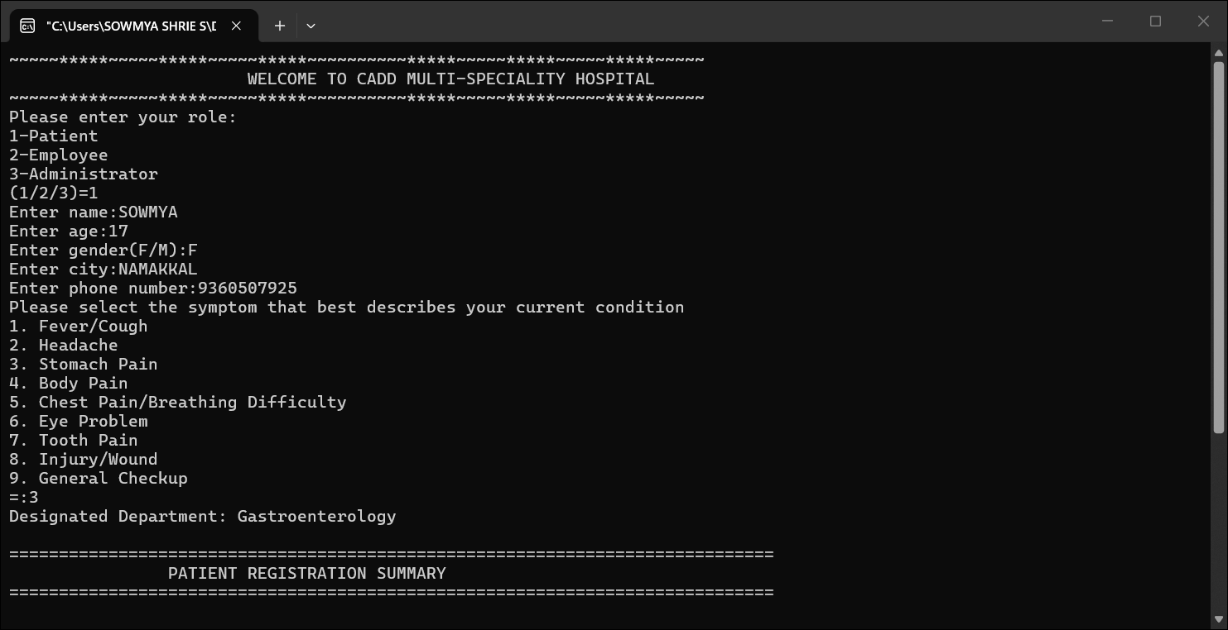
Patient Module

Slide 10
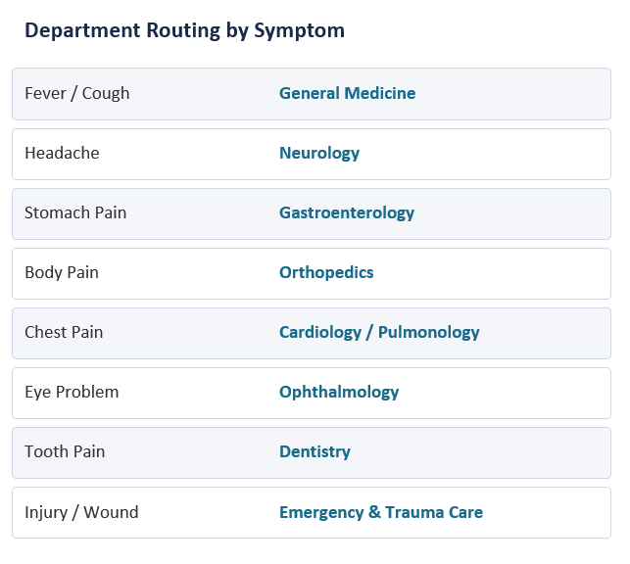
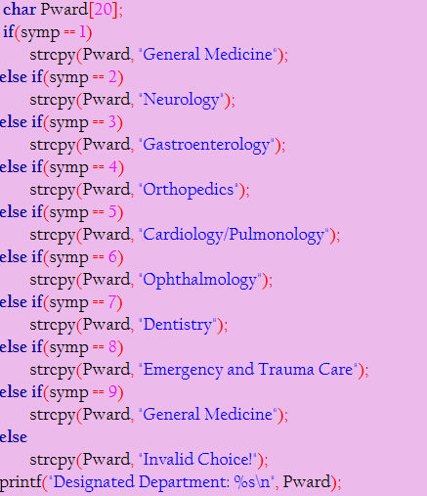
Patient Module
BY IF-ELSE IF-ELSE BLOCK

Slide 11
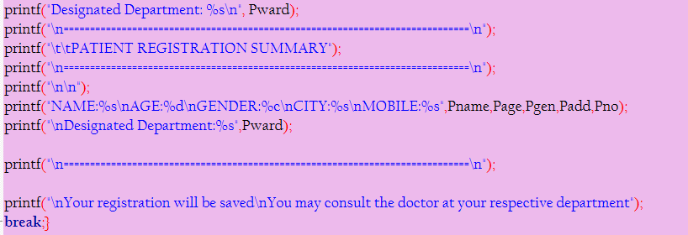
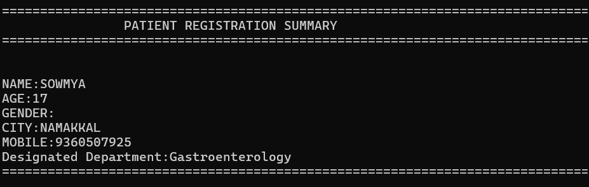
Patient Module
Stored data is
presented
in a summarized
format
F

Slide 12
EMPLOYEE
(CASE 2)

Slide 13

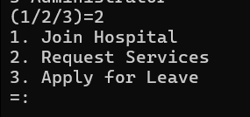
Employee Module
1. Join Hospital
2. Request Services
3. Apply for Leave
Shift Change Request
→ Forwarded to supervisor
Appointment with Admin
→ Submitted to manager
Confirmation via notification
Employee ID
Number of leave days
Reason for leave
Application submitted
Notification on review
Employee ID
Name & Age
Phone Number
Designation
Department
Salary
Record saved to file

Slide 14
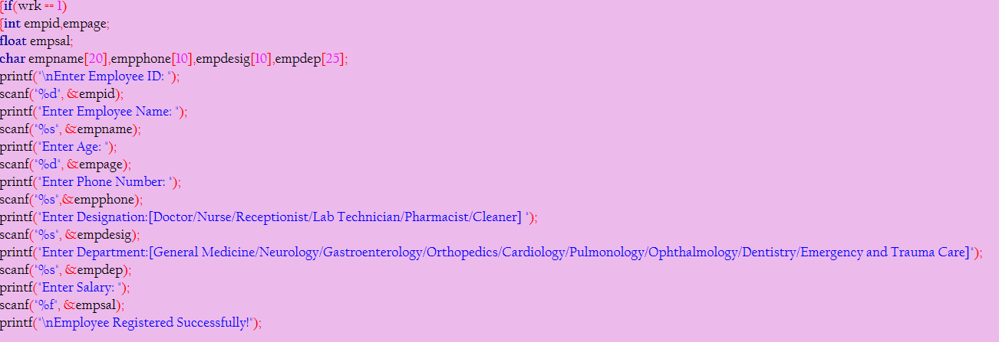
Employee Module
1.JOIN HOSPITAL

Slide 15
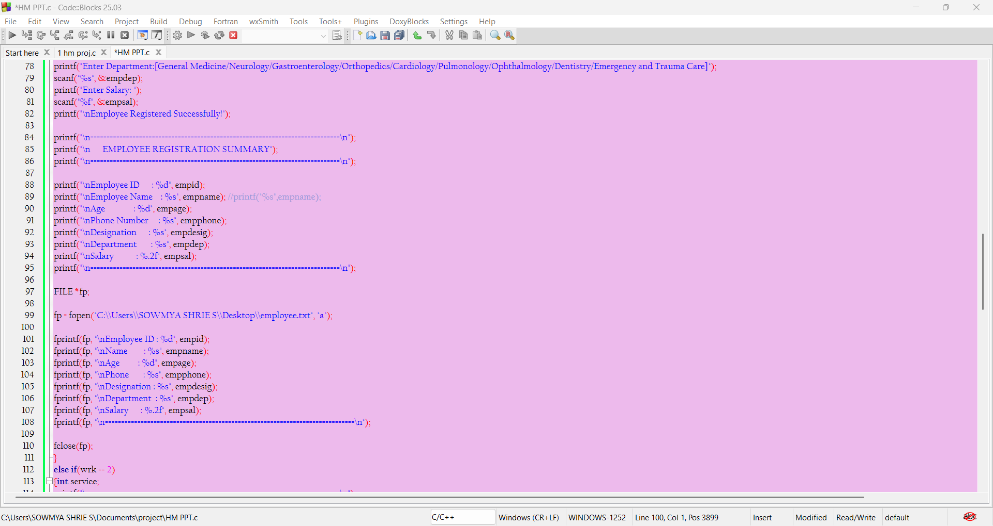
Employee Module
1.JOIN HOSPITAL
A SUMMARY OF THE
DETAILS OF THE EMPLOYEE
WILL BE DISPLAYED AND
IS APPENDED
INTO A FILE CALLED
EMPLOYEE WHICH
IS MANAGED
BY THE HOSPITAL
1.JOIN HOSPITAL
FILE POINTER
FILE OBJECT(APPEND MODE)
CLOSING THE FILE

Slide 16
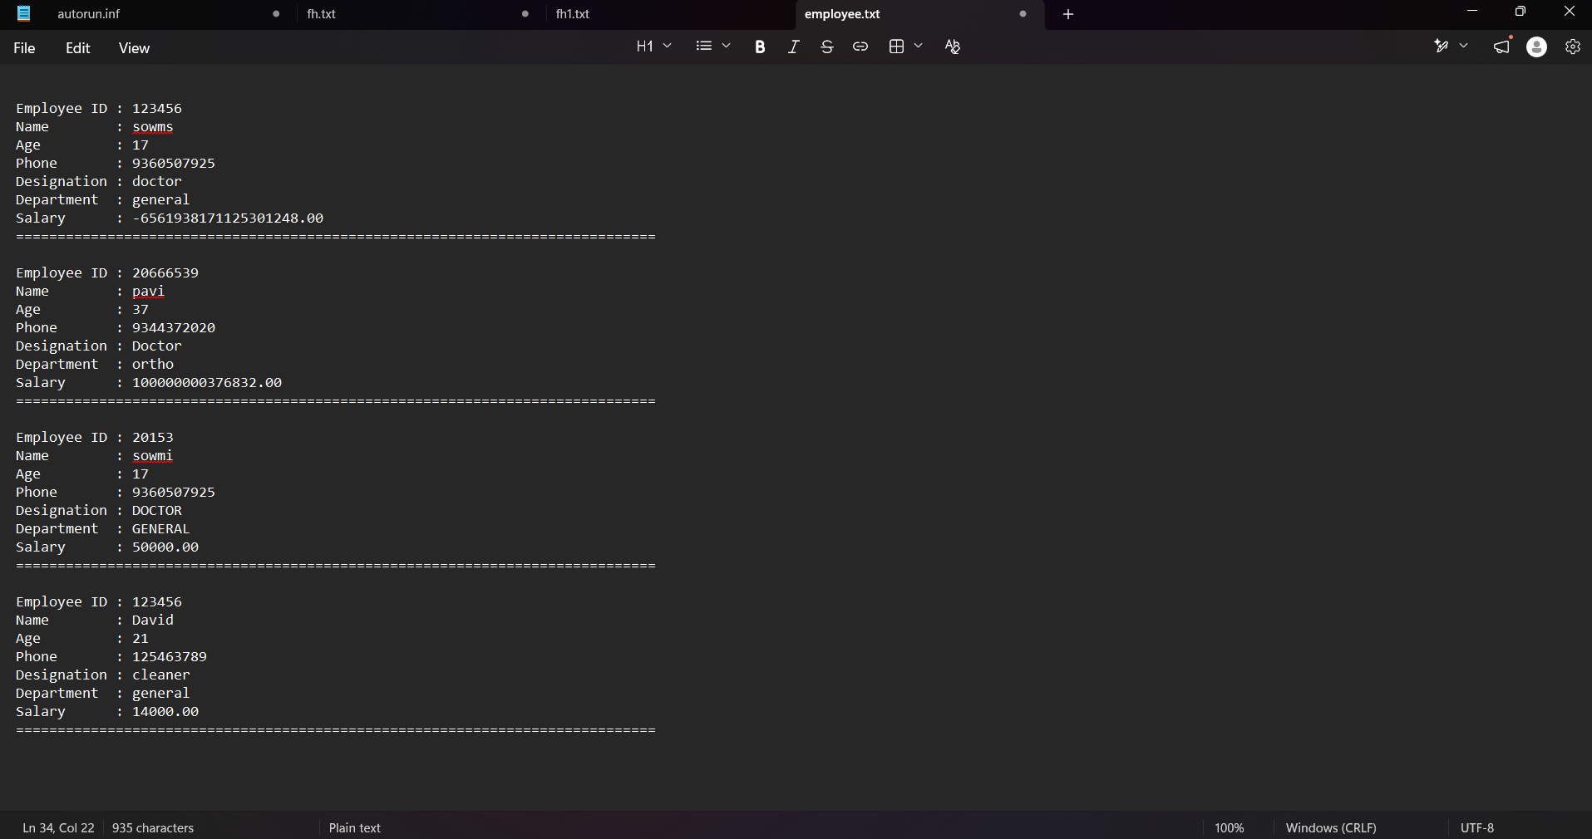
THE TEXT FILE WHICH STORES THE DATA OF THE EMPLOYEES

Slide 17
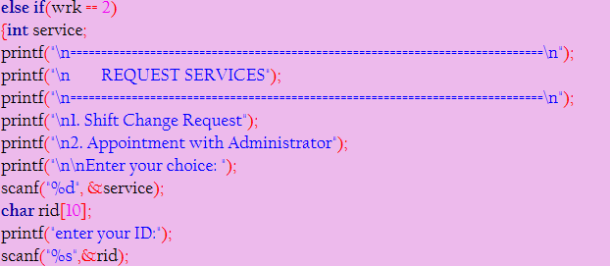
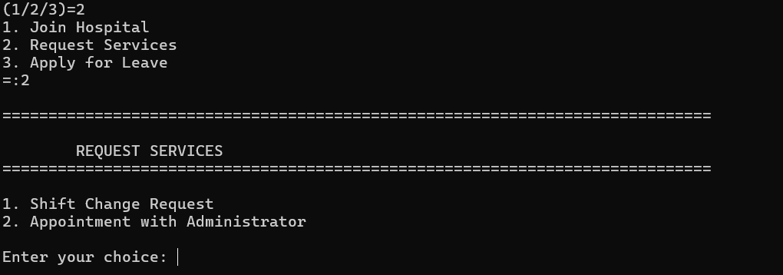
Employee Module
2.REQUEST SERVICES
This module allows employees to submit
service requests.
The system acknowledges
the request and
informs the employee
that it has been
forwarded to the appropriate authority
for further review.

Slide 18
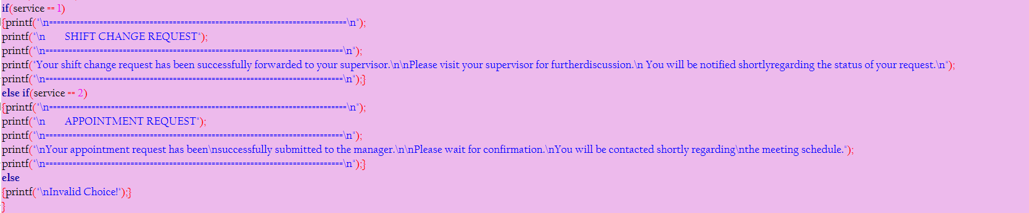
Employee Module
2.REQUEST SERVICES

Slide 19
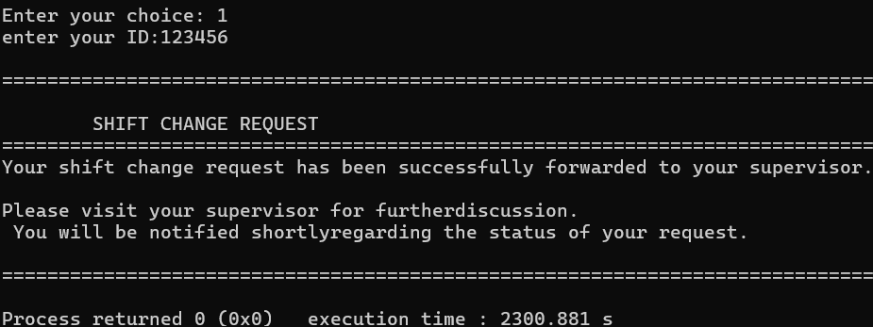
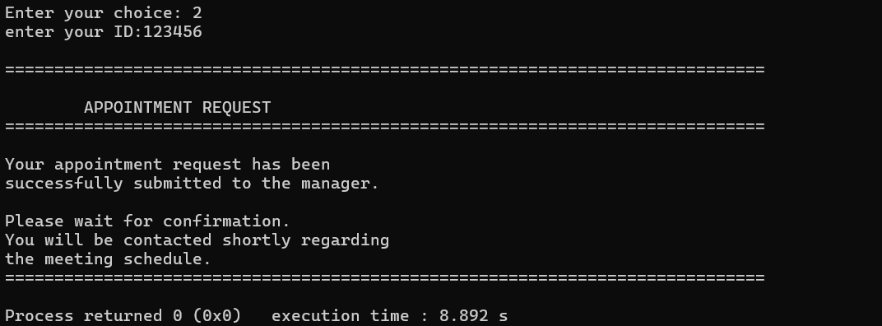
Employee Module
2.REQUEST SERVICES

Slide 20
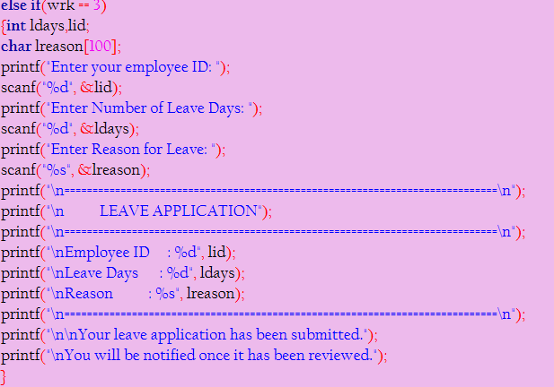
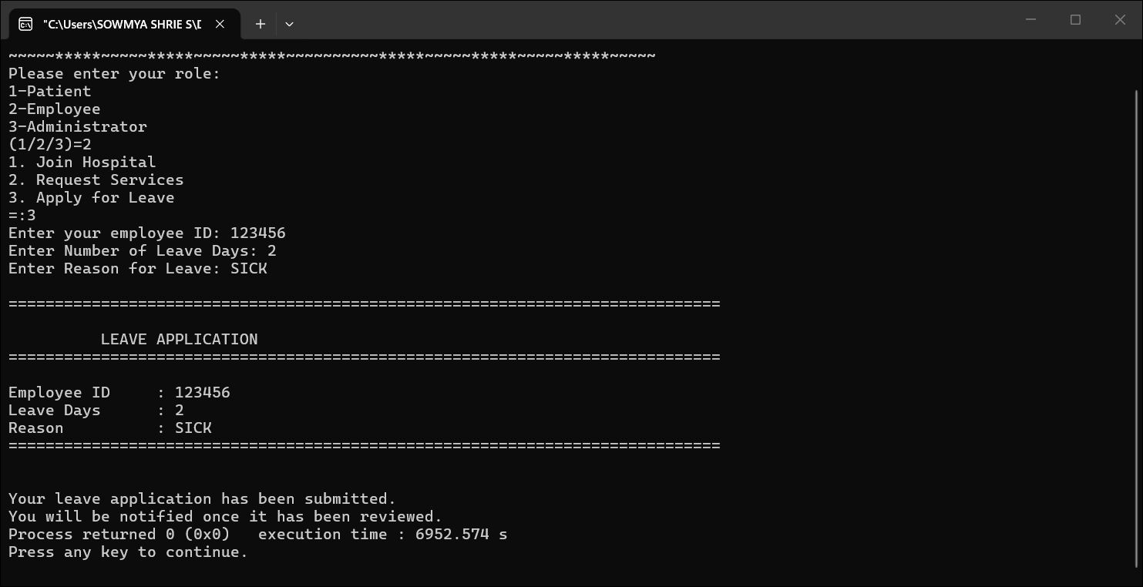
Employee Module
3.LEAVE APPLICATION

Slide 21
ADMIN
(CASE 3)

Slide 22
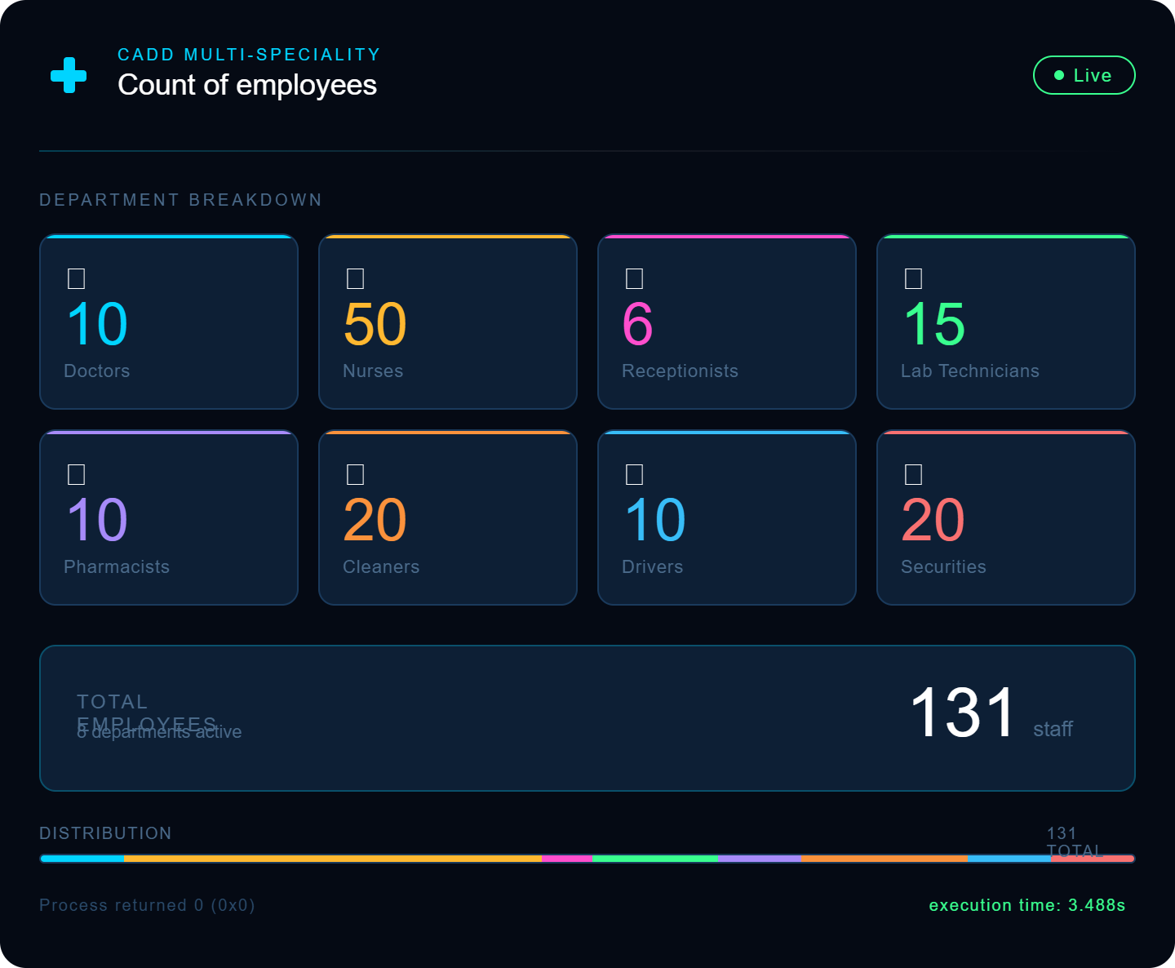
Administrator Module

Slide 23
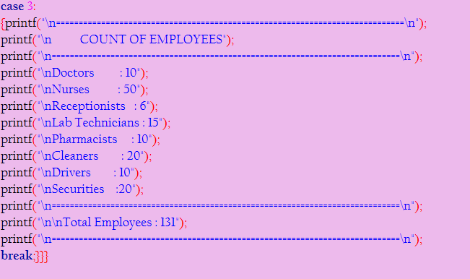
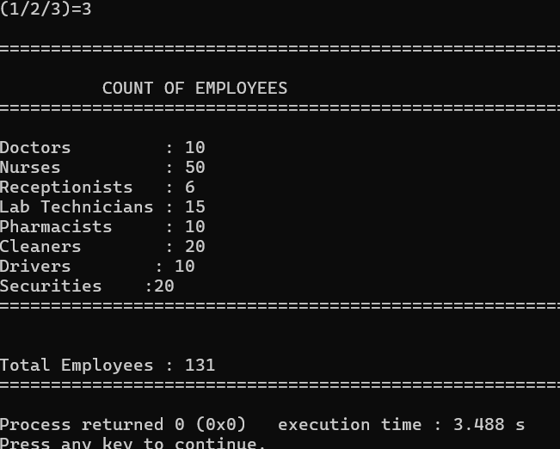
Administrator Module

Slide 24
Code Snapshot — Core Logic
#include <stdio.h>
#include <string.h>
int main() {
printf("WELCOME TO CADD MULTI-SPECIALITY HOSPITAL");
int Pr; // Person's role (1=Patient, 2=Employee, 3=Admin)
scanf("%d", &Pr);
switch(Pr) {
case 1: // Patient Registration & Department Routing
case 2: // Employee Management (Join / Request / Leave)
case 3: // Administrator Dashboard
}
}

Slide 25
Conclusion
The CADD Multi-Speciality Hospital Management System demonstrates the practical application of C programming in real-world healthcare contexts. Leveraging core C constructs — conditional logic, switch-case routing, file I/O, and structured data — the system efficiently handles three distinct user roles.
Demonstrates real-world use of C constructs
Role-based access improves system integrity
Symptom-based routing enhances patient care
File I/O ensures persistent employee records
Scalable structure suitable for further enhancement
Thank You — CADD Multi-Speciality Hospital

Slide 26
THANK YOU

